Slide 1

Smart Order & Inventory Management System
By: Garvit Agarwal

Slide 2



Why Build This?
Manual order processing leading to operational delays
No centralized or real-time inventory tracking
Poor coordination between sales, warehouse, and finance teams
Limited visibility into sales performance and stock movement

Slide 3



Objective
To design and develop a Full-Stack Enterprise Application that:
Uses Java Spring Boot as the backend
Uses Angular for frontend development
Implements JWT-based authentication and authorization
Applies clean architecture, layered design, and best practices
Demonstrates real-world CRUD operations, security, validations, and reporting use cases

Slide 4


What is SmartLogistics?
Unified Platform: A single portal for Admins, Customers, and Managers.
Real-Time Inventory: Stock updates instantly upon order placement.
Secure: JWT-based Authentication with strict Role-Based Access (Admin vs. Customer).
Scalable: Built on Microservices architecture.

Slide 5
How do the pieces fit together?
Frontend: Angular (Standalone Components, Signals for State Management).
API Gateway: The single entry point that handles routing and security context.
Microservices:
User Service: Handles Login/Register & JWT generation.
Product Service: Manages Inventory & CRUD operations.
Order Service: Handles Cart logic & Order placement.
Billing Service: Handles Invoice Creation
Database: MySQL (Relational Data persistence).

Slide 6
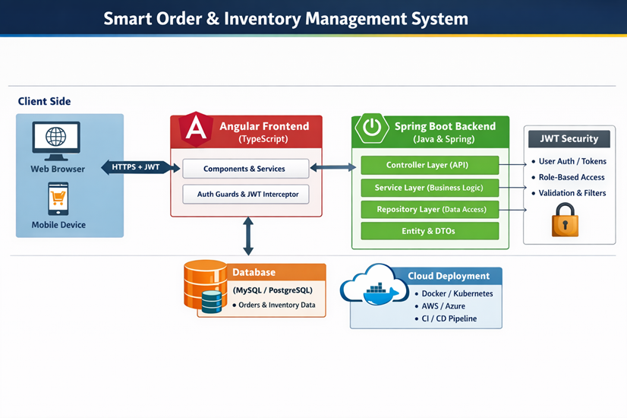
Architecture

Slide 7
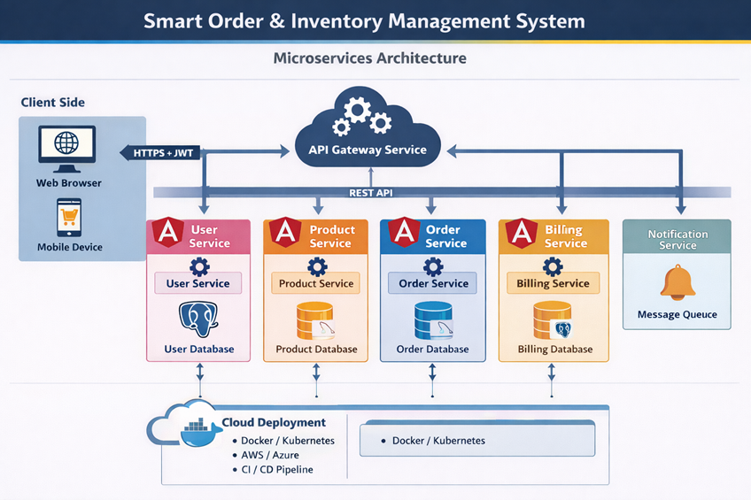
Backend Design

Slide 8
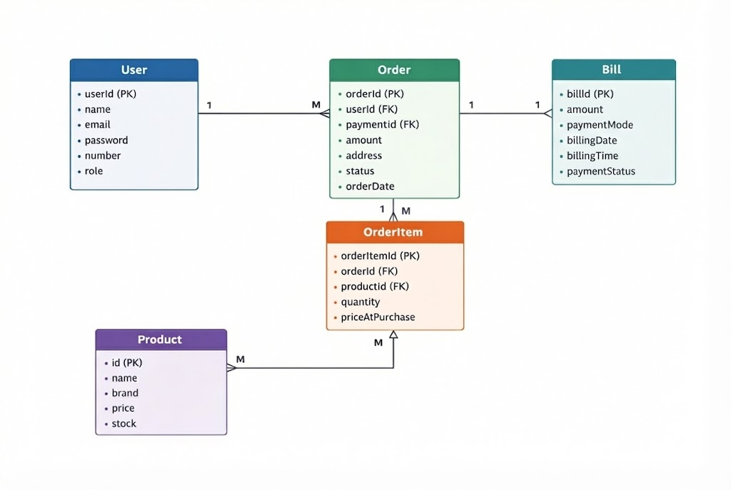
Database Design

Slide 9

Key Features

Slide 10
"The Shopping Experience"
Product Catalog: Visual grid with "In Stock" indicators.
Smart Cart: * State maintained via Angular Signals (No page reloads).
Real-time total calculation.
Checkout: * Address & Payment mode selection.
My Orders: History tracking with status updates.

Slide 11
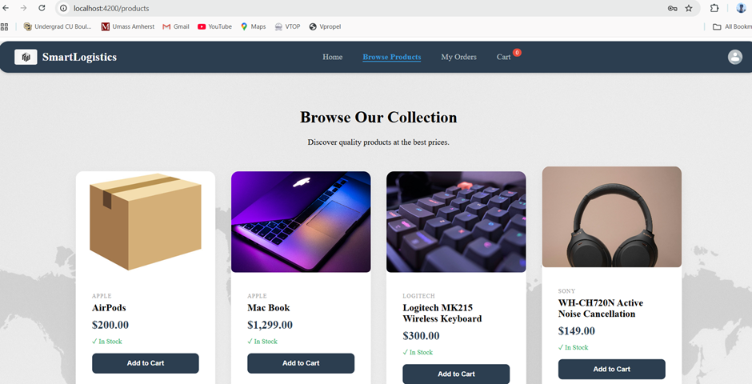

Slide 12
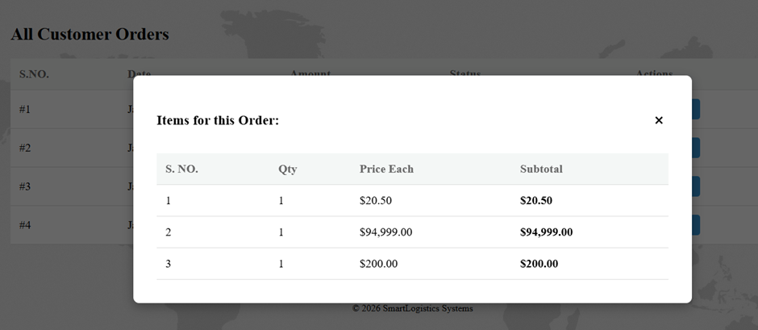
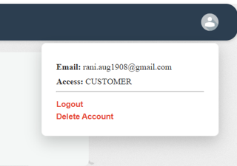
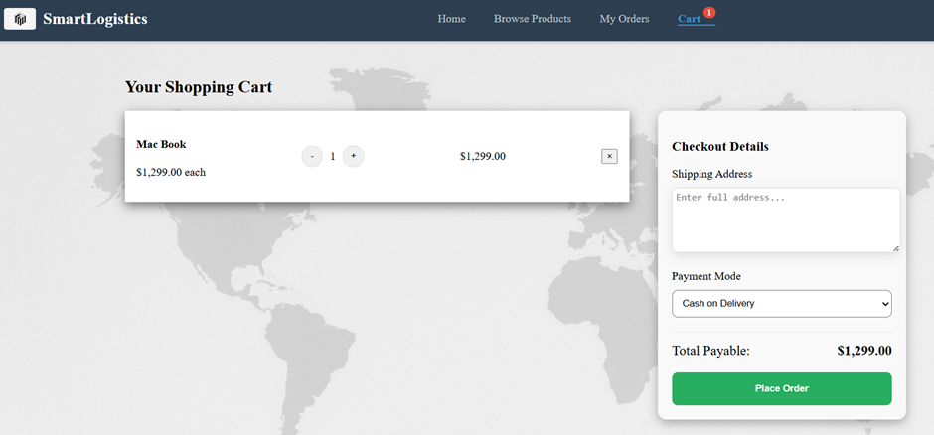
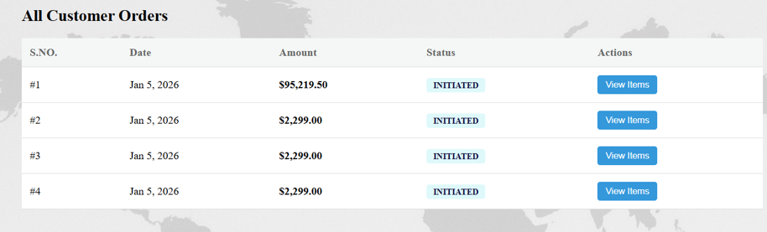

Slide 13
“Z+ Security”
JWT (JSON Web Tokens): Implemented stateless authentication.
Role-Based Access Control (RBAC)
BCrypt Password Hashing
API Gateway Security
Input Validation

Slide 14
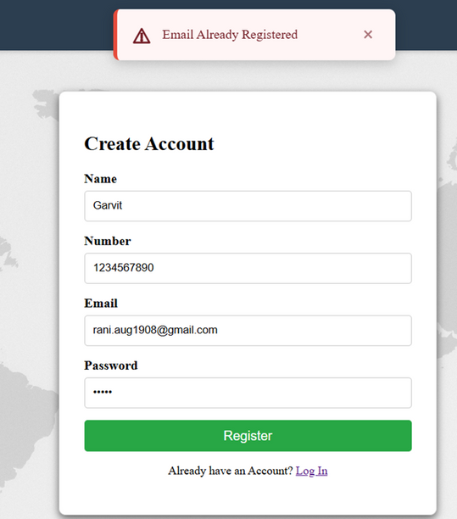
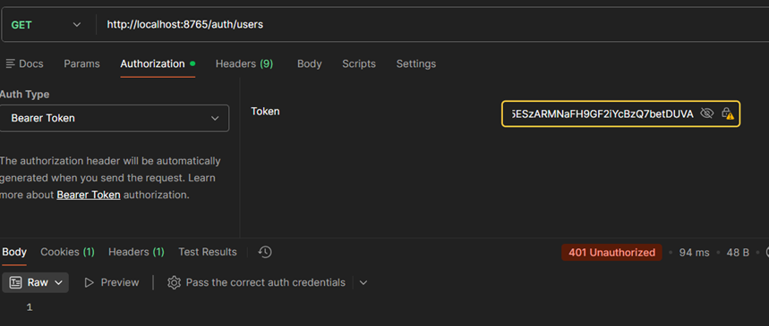
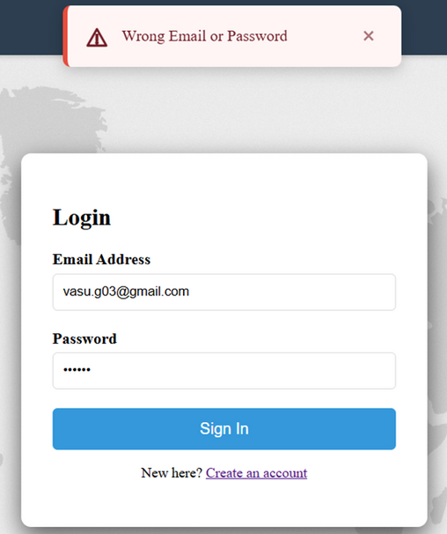
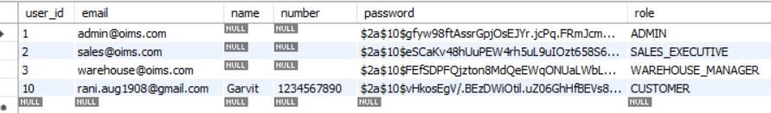

Slide 15
The Control Center
1) Admin
Inventory Management
Order Management
Finance
2) Sales-Executive
Order Management
3) Warehouse_Manager
Inventory Management
4) Finance-Officer
Finance

Slide 16
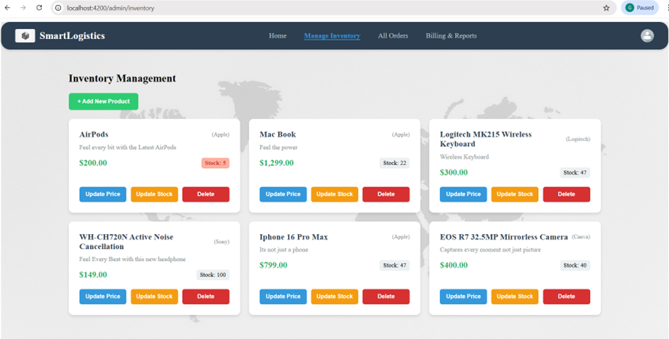

Slide 17
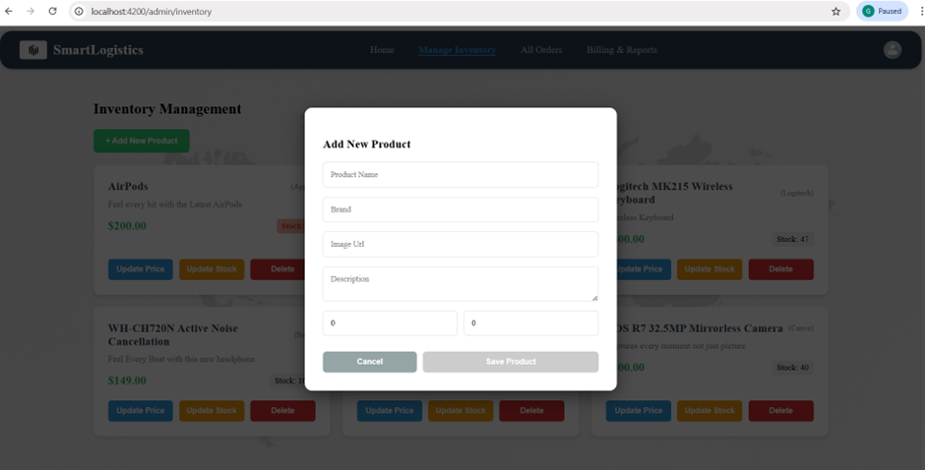
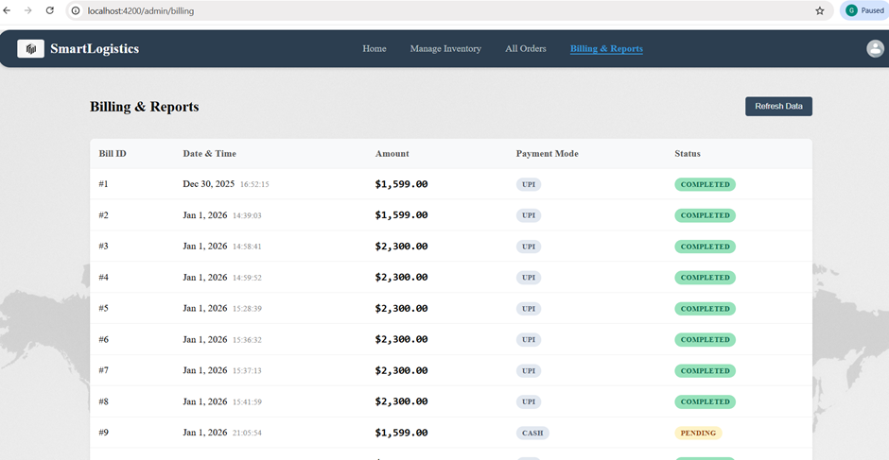
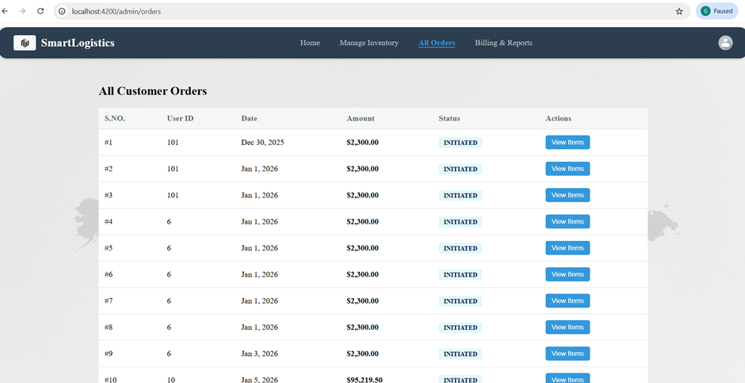

Slide 18
The "Wow" Factor
Http Interceptors: Automatically attaches the JWT Token to every request, keeping the service code clean.
Reusable Components: Built a "Global Confirmation Service", “Global Popup component”, “Global input box”.
Email Notifications: Sending invoices via SMTP when an order is placed and when the user registers.

Slide 19
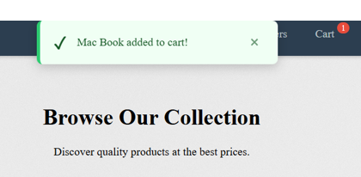
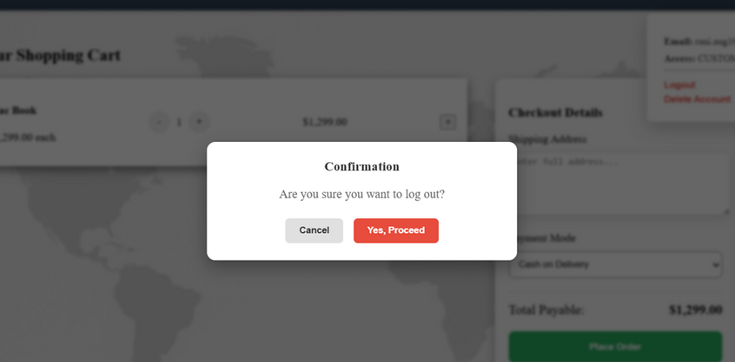
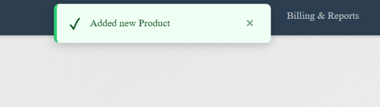
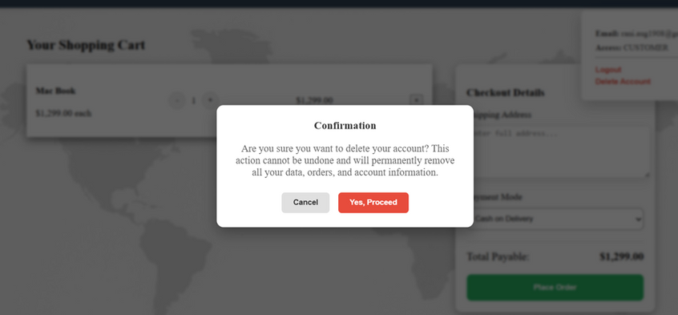
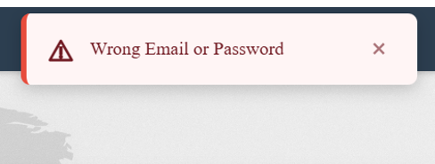
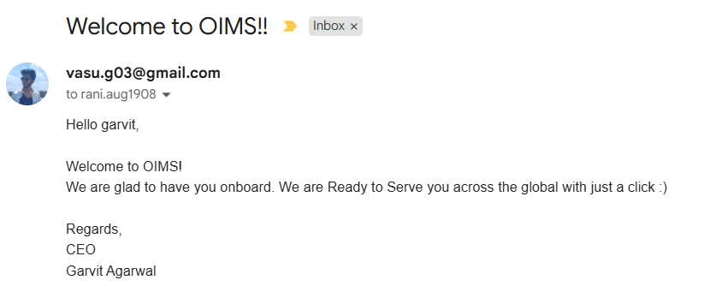

Slide 20

What's next?
Payment Gateway: Integrating Stripe/Razorpay for real payments.
Analytics Dashboard: Charts showing sales trends over time.

